Slide 1
Electrochemistry
Chapter 9

Slide 2
Terms for Electrochemistry
Oxidation is the loss of electrons
Reduction is the gaining of electrons
OIL RIG
The substance that loses the electrons is the reducing agents (causes another substance to be reduced – gain electrons)
The substance that gains the electrons is the oxidising agent (causes another substance to be oxidised – lose electrons)

Slide 3
Oxidation and Reduction
Oxidation
Zn(s) → Zn²⁺ _{(aq)} + 2e⁻
Metallic zinc is oxidised to zinc ion. Metallic zinc is acting as reducing agent
Reduction
Cu²⁺ _{(aq)} + 2e⁻ → Cu(s)
Copper ion is reduced to copper metal. Copper ion is serving as an oxidising agent
Overall: 2e⁻ transferred from Zn_{(s)} to Cu_{(s)}
Zn_{(s)} + Cu²⁺_{(aq)} → Zn²⁺_{(aq)} + Cu_{(s)}

Slide 4
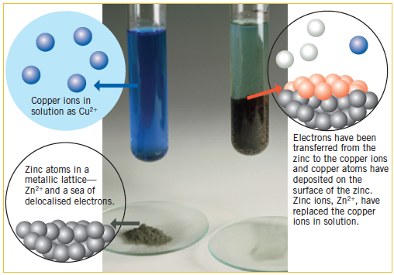
Before and After…

Slide 5
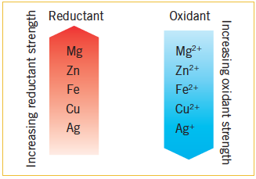
Strength of reductant and oxidant…
Zinc more reactive than copper.
Therefore loses its electrons and is oxidised.
Called a reducing agent or reductant.

Slide 6
Old Transition Lenses
Based on REDOX reaction involving Cu, Ag and UV light
Cu + UV → Cu2+ + e-
Ag + e- → Ag
Silver crystals caused glasses to go dark, reverse occurs when no UV light.

Slide 7
Oxidation Numbers
Oxidation numbers are used when it is difficult to identify which substance loses and gains electrons and how many…
Example:
H⁺ + MnO₄⁻ + Cl⁻ → Mn²⁺ + Cl₂ + H₂O
Here we need oxidation numbers!!

Slide 8
Rules for assigning oxidation numbers
Elements have oxidation numbers of zero. Monatomic (noble gas), molecule or covalent network – example Ne, H₂, O₃, P₄ or C (diamond)
The oxidation number of a monatomic ion is the charge on the ion. Example: Cu²⁺ has o.n. of +2. In Cl⁻ the o.n. = -1. Elemental groups e.g. group 1 = +1, group 2 = +2 etc…
Oxidation number of combined oxygen is -2 except in peroxides (e.g. Na₂O₂, H₂O_{2,} o.n. = -1 and exception F₂O o.n. = +2)

Slide 9
Rules continued…
4. Combined hydrogen is always +1 except metal hybrides (e.g. NaH)
The sum of all the oxidation numbers of the atoms in a molecule is equal to its charge. If no charge then equals zero example CO₂
In polyatomic ion must equal to charge on ion example SO₄²⁻
Balance oxygen by adding by adding water and balance hydrogen by adding hydrogen

Slide 10
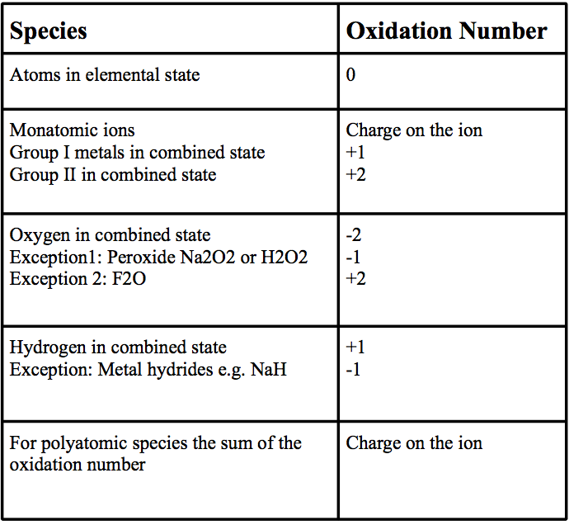
Summary

Slide 11
Finding unknown oxidation numbers
Problem: What is the oxidation number of Mn in MnO₄⁻, the permanganate ion?
Solution: Mn is unknown
Each O is –2 (rule 3)
All of the oxidation numbers must add up to –1 (rule 5)
Mn + 4(-2) = -1, Mn = +7 in permanganate
Problem: What is the oxidation number of Cr in K₂Cr₂O₇, potassium dichromate?
Solution: Cr is unknown
Each K from Column I is +1
Each O is –2 (rule 3)
All the oxidation numbers add up to 0 (no charge on K₂Cr₂O₇)
2(+1) + 2 Cr + 7(-2) = 0, 2 Cr = 12, Cr = 12 / 2 = +6
Cr = +6 in potassium dichromate

Slide 12
Using oxidation numbers…
Using oxidation numbers we will find the oxidising agent, the reducing agent, the number of electrons lost and gained, the oxidation half-reaction, the reduction half-reaction and the final balanced equation for:
H⁺ + MnO₄⁻ + Cl⁻ → Mn⁺² + Cl₂ + H₂O

Slide 13
Using oxidation Numbers step by step..
Step I – Find the oxidation number of each atom.
H⁺ + MnO₄⁻ + Cl⁻ → Mn⁺² + Cl₂ + H₂O
+1 (+7, -2) -1 +2 0 (+1, -2)
Step II – Which oxidation numbers change? MnO₄⁻ → Mn⁺² 2 Cl⁻ → Cl₂
+7 → +2 2(-1) → 0
5 electrons gained 2 electrons lost
Identify oxidising and reducing agents.
(MnO₄⁻ is the oxidising agent. It gained e- from Cl⁻ )
(Cl⁻ is the reducing agent. It lost e- to MnO₄⁻ )

Slide 14
continued....
Step III - Electrons lost by a reducing agent must always equal electrons gained by the oxidising agent!
Balance electrons in each half equ
Therefore: 2Cl⁻ → Cl₂ + 2e⁻
5(2Cl⁻ → Cl₂ + 2e⁻)
10 Cl⁻ → 5Cl₂ + 10e⁻ (oxidation half-eqn*)
And: MnO₄⁻ + 5e⁻ → Mn⁺²
2 (MnO₄⁻ + 5e⁻ → Mn⁺² )
2MnO₄⁻ + 10e⁻ → 2Mn⁺² (reduction half-eqn)

Slide 15
continued…
Step IV – Balance first half-reaction by adding H⁺ ions and H₂O molecules:
16 H⁺ + 2MnO₄⁻ + 10e⁻ → 2Mn⁺² + 8 H₂O
Step V - Adding the oxidation half-reaction and reduction half-reaction the 10 electrons gained and lost cancel to give the overall reaction:
16H⁺ + 2MnO₄⁻ + 10Cl⁻ → 2Mn⁺² + 5Cl₂ + 8H₂O
* Half-equations refers to the reaction showing either the electron gain (reduction) or the electron loss (oxidation) step of the reaction.

Slide 16
No change in oxidation numbers
Is no change in oxidation numbers then it is not a REDOX reaction…
For example:
CO₃²⁻_{(aq)} + 2H_{(aq)} → H₂O_{(l)} + CO_{2(g)}
+4 –2 +1 +1 –2 +4 –2

Slide 17
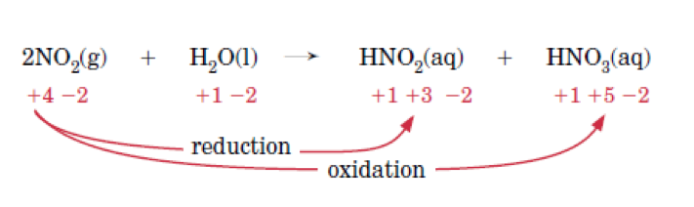
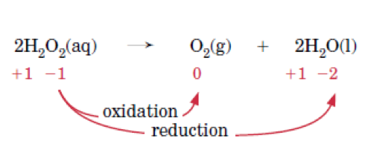
Disproportionation – single substance undergoes oxidation and reduction

Slide 18
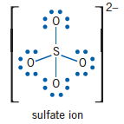
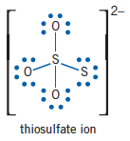
Oxidation numbers does not always correlate to charge on the ion
Example thiosulfate ion S₂O₃²⁻
Here due to it shape one sulfur has oxidation number of +6 other has oxidation number of -2.
This also occurs in some organic compounds and elements in group 15 to 17

Slide 19
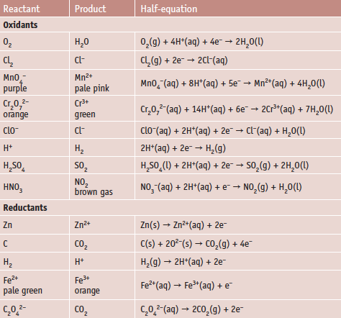

Slide 20
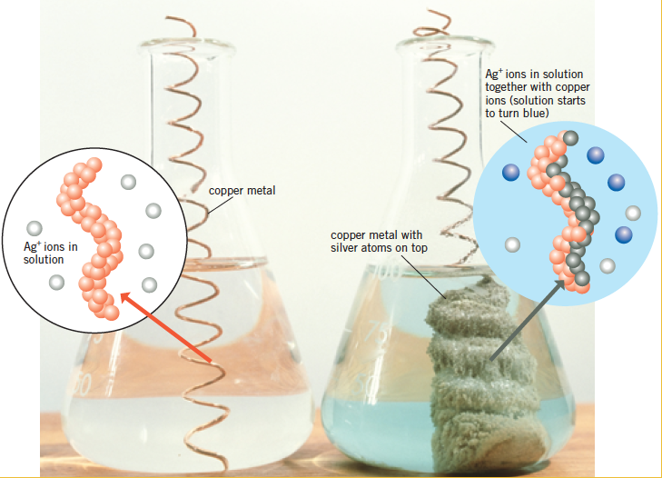
Changes to copper when placed in solution containing silver ions

Slide 21
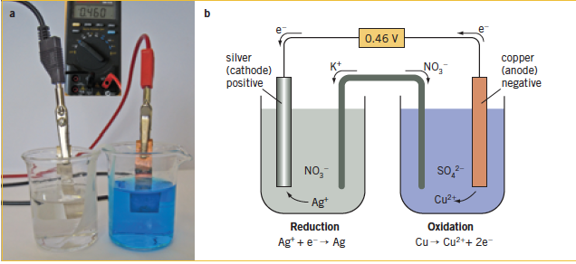
REDOX - Producing electrical energy
To do this an electrochemical cell must be build which transfers electrons from the reductant to the oxidant rather that allowing the reactants to come in direct contact.

Slide 22
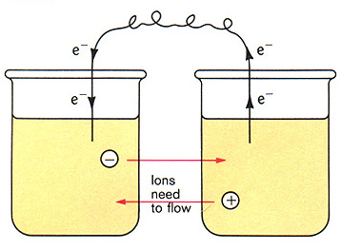
Electrolysis
To do this you have to separate the two half equations from one another and provide a path for the electrons to flow
Half-cell where reduction occurs
Half-cell where oxidation occurs
But there is a problem…….

Slide 23
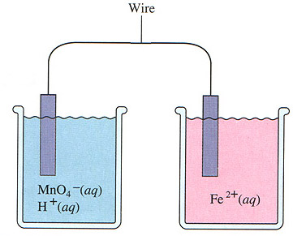
e-
e-
Electrons should move through the wire from Fe²⁺ to MnO₄⁻. But they wont
e-
e-
Oxidizing agent
Reducing agent
Becomes negative as electrons arrive
Becomes positive as electrons leave

Slide 24
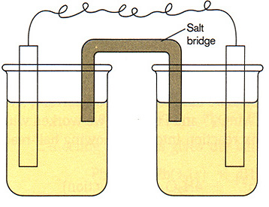
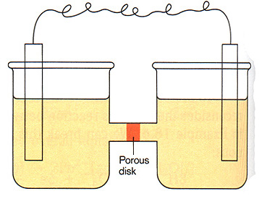
This problem can be solved
The solutions need to be linked so that ions can can also flow to keep the net charge in each beaker equal.
This can be done by using a salt bridge
Or a porous disk in a tube linking the two solutions.

Slide 25
Electrons are picked
up by cations at the
cathode (reduction occurs)
Cu
Cu⁺²
Electrons move
through the
external circuit
from anode to cathode.
Copper is deposited
at the cathode
Cu
Cu⁺²
Cu
Cu⁺²
Cu⁺²
+2
Cu⁺²
Cu + 2 e Cu

Slide 26
Electrons are lost at the
anode (oxidation occurs)
Zn
Zn⁺²
Electrons move
through the
external circuit
from anode to cathode.
Zinc is dissolved
at the anode.
Zn
Zn⁺²
Zn
Zn⁺²
Zn
+2
Zn
Zn Zn + 2e

Slide 27
Electrochemical cell..
Two metals are called electrodes.
Anode is where oxidation occurs (negative)
Cathode is where reduction occurs (positive)
Salt bridge contains electrolyte usually a saturated solution whose ions will not react. It’s ions migrate from the salt bridge to neutralise increasing positive or negative solutions

Slide 28
Summary
Oxidation takes place at the anode.
Reduction takes place at the cathode.
In an electrochemical cell the anode is negative—electrons are produced at this electrode.
In an electrochemical cell the cathode is positive—electrons are consumed at this electrode.
Electrons flow from the anode to the cathode through a wire in the external circuit.
Anions are negative ions and migrate through the salt bridge towards the anode.
Cations are positive ions and migrate through the salt bridge towards the cathode.
Both the oxidant and its 'conjugate' reductant are normally present in a half-cell.

Slide 29
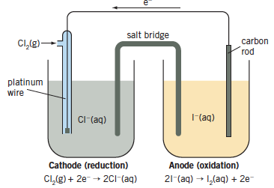
Electrochemical cell using a gas
Electrochemical cell does not need to use metals – example reaction of Cl gas and potassium iodide to form Cl⁻_{(aq)} and I_{2(aq)}
Inert electrodes (platinum or graphite) are needed to transfer electrons and not react.

Slide 30
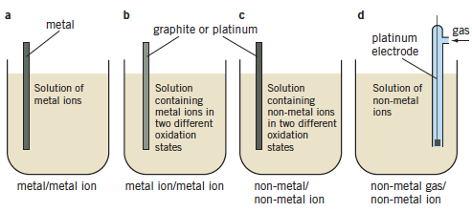
Four different types of half cells

Slide 31
Electrochemical Cell Conventions
Electrochemical cell that release energy spontaneously are call voltaic or galvanic cells. Those which require energy input in order to function are call electrolytic cells.
Voltaic cells are often represented as follows for the reaction: Zn_{(s)} + Cu⁺²_{(aq)} → Zn⁺²_{(aq)} + Cu_{(s)}
Zn / Zn⁺² (1.0 M) // Cu⁺² (1.0 M) / Cu
Solution
concentration
Solution
concentration
Anode
Compartment
components
Salt
bridge
Cathode
Compartment
components

Slide 32
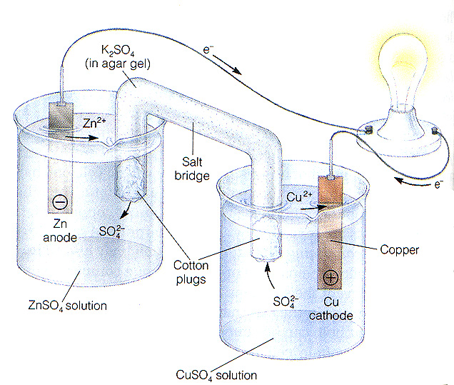
This is called an electrochemical battery or a galvanic cell
The electrons are forced to flow through a wire by separating the reducing agent from the oxidising agent.

Slide 33
Oxidation occurs at the anode
Reduction occurs at the cathode

Slide 34
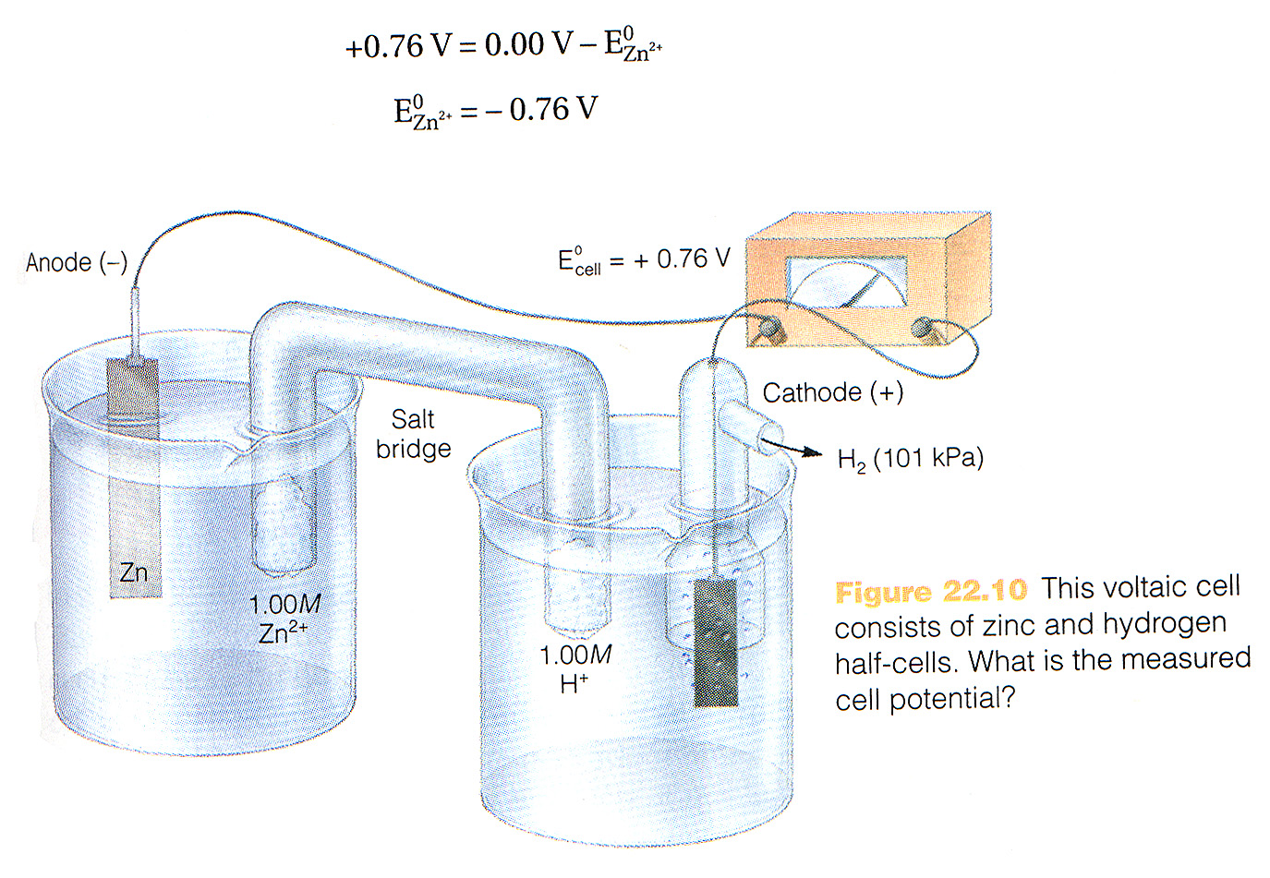

Slide 35
Electric potential and standard reduction potentials
Electric potential is the measure of the electron attracting power of an oxidising agent (electron gainer) in a half-cell.
When two different oxidant – one with high electric potential and one with low electric potential → electrons are pulled towards half-cells with stronger oxidant
Cell potential is the difference in electric potential of its two half cells

Slide 36
Cell potential
Also called emf, electromotive force or voltage of cell.
Referred to as the potential difference and is measured in volts (V)
Measured by a voltmeter
E symbol for electric potential
E_{cell} is symbol for cell potential

Slide 37
E _{cell}
Depends on concentration of the electrolytes, the pressure of any gases and the temperature.
Eº_{cell} is standard cell potential – when conditions are 1 mol L-1 conc of dissolved substances, 101.3kPa(1atm) pressure and 25ºC

Slide 38
Electrical Potential
Electrical potential is measured in volts and indicates the tendency of electrons to move from one substance to another.
Potential depends on a variety of factors such as the concentration of reactant materials, temperature, gas pressures and the nature of the materials involved.

Slide 39
Reduction Potentials
Standard Reduction Potentials (measure the tendency of a substance to gain electrons) are determined at 25⁰C, 1M conc, 1 atm pressures
They are compared to hydrogen ion’s tendency to be reduced (gain electrons) to hydrogen gas (2H⁺_{(aq)} + 2e⁻ → H_{2(g)}) which is assigned a potential of 0.00 volts.
Substances which gain electrons better than H⁺ ion are assigned positive potentials. Those which gain electrons more poorly than H⁺ ion are assigned negative potentials.

Slide 40
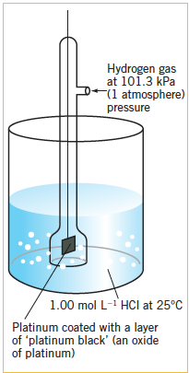
Standard hydrogen half-cell
2H(aq) + 2e ⇌ H2(g) E° = 0 V
This is used as a reference to compare other half-cells

Slide 41
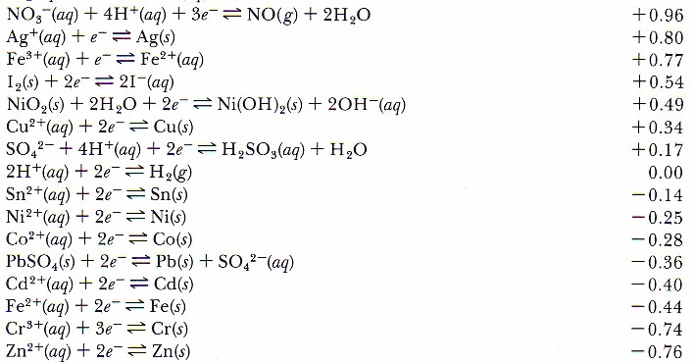
Standard Reduction Potential

Slide 42
An electrochemical cell
EMF
1.100
VOLTS
electrons
SALT BRIDGE
Cl-
K+
Cu
Zn
ANODE
(OXIDATION
OCCURS)
CATHODE
(REDUCTION
OCCURS)
Zn
+2
Cu
+2
Zn_{(S)} → Zn⁺²_{(aq)} + 2 e⁻
E⁰ = 0.763 volts
Cu⁺²_{(aq)} + 2 e⁻ → Cu_{(s)}
E⁰ = 0.337 volts

Slide 43
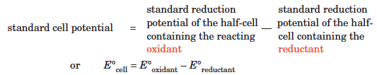
Calculating Eº_{cell}

Slide 44
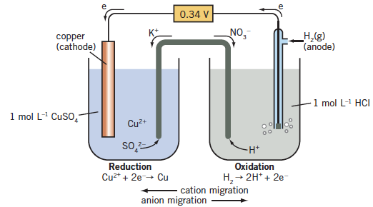
Copper and hydrogen
Copper gains electrons from hydrogen and has a positive reduction potential of + 0.34V

Slide 45
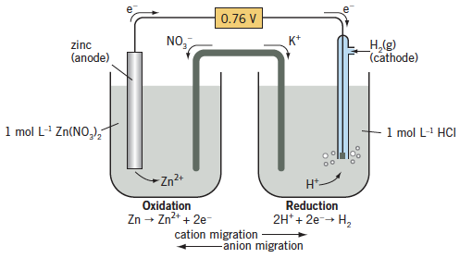
Zinc and hydrogen
Zinc is oxidised, therefore has a lower reduction potential than hydrogen. Given negative reduction potential -0.76volts

Slide 46
Generalisation with Standard Reduction Potential table
Oxidants are on left reductants on right
The more positive the reduction potential the stronger the oxidant
The more negative the reduction potential the stronger the reductant
Equilibrium arrows are used to represent the half-cell reactions because these reactions can proceed in both directions, depending what is present in the other half-cell.
The cell potential of any combination of these half-cells is calculated from the half-cell reduction potentials using the expression:
E°cell = E°half-cell containing – E°half-cell containing the oxidant the reductant

Slide 47
Generalisations continued…
Oxidants generally only react with reductants that have a more negative E° (standard reduction potential) value.
The greater the difference in E° values the more likely the reaction is to proceed in the direction predicted. The greater the difference in E° values, the larger the equilibrium constant for the reaction.
Even when there may be a large difference in standard reduction potentials, the cell potential does not predict how fast the reaction will take place. It is possible that the rate of reaction at 25° is very slow.

Slide 48
Calculate cell potential
Cu_{(s)} + 2Ag⁺_{(aq)} → Cu²⁺_{(aq)} + 2Ag(s)
From standard potential table
Ag⁺_{(aq)} + e– ⇌ Ag_{(s)} E° = +0.80 V
Cu²⁺_{(aq)} + 2e– ⇌ Cu_{(s)} E° = +0.34 V
E°cell = E°oxidant – E°reductant
E°cell = +0.80 – (+0.34) = 0.46V

Slide 49
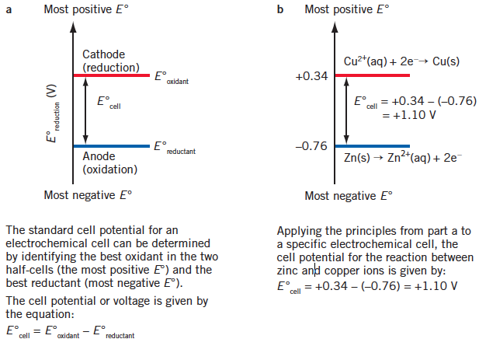
Calculate Cell potential

Slide 50
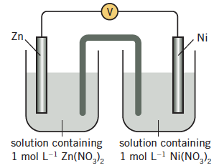
Ni2+(aq) + 2e– ⇌ Ni(s) E° = –0.26 V
Zn2+(aq) + 2e– ⇌ Zn(s) E° = –0.76 V
E°cell = E°oxidant – E°reductant
= E°nickel half-cell – E°zinc half-cell
= –0.26 – (–0.76)
= 0.50 volts

Slide 51
Predicting whether reactions will take place
Redox reaction will occur when one reactant is an oxidant and other is a reductant
Difference in Eo values
Greater the Eo value the larger the equilibrium constant for the reaction (no effect on reaction rate)
Must be under standard conditions of temperature and pressure

Slide 52
Standard Reduction Potentials can be used to explain….
Metal displacement reactions
Halogen displacement reactions
Reactions of metals with water—any metal with a reduction potential less than around –0.4 V will react with water (even if it is very slow)
Reactions of metals with acids—metals with a reduction potential (E°) less than 0.0 V will react with HCl and dilute H₂SO₄ to form H₂. Metals with a reduction potential (E°) less than 0.95 V will react with reasonably concentrated nitric acid to form NO_{(g)} (which will immediately oxidise to brown NO_{2(g)} in the presence of air).

Slide 53
Standard Reduction Potentials can be used to explain….
Many substances will only react if acid is present, for example MnO₄⁻_{(aq)} and Cr₂O₇²⁻_{(aq)}
In an aqueous solution the very weak oxidant metal ions will not participate in a redox reaction. Cations of group 1 and 2 metals together with Al_{3(aq)} can be ignored when predicting redox reactions involving aqueous solutions.

Slide 54
Standard Reduction Potentials can be used to explain….
Nitrate ions and sulfate ions will not participate in redox reactions unless they are present as reasonably concentrated nitric acid or sulfuric acid:
Nitric acid—when a metal reacts with the concentrated acid, nitrogen dioxide is formed:
NO₃⁻_{(aq)} + 2H⁺_{(aq)} + e⁻ → NO_{2(g)} + H₂O_{(l)}
When a metal reacts with less concentrated acid (4–6 mol L⁻¹), nitrogen monoxide forms:
NO₃⁻_{(aq)} + 4H⁺_{(aq)} + 3e⁻ → NO_{(g)} + 2H₂O_{(l)}
Sulfuric acid—when a metal reacts with concentrated sulfuric acid, sulfur dioxide forms:
SO₄²⁻_{(aq)} + 4H⁺_{(aq)} + 2e⁻ → SO_{2(g)} + 2H₂O_{(l)}

Slide 55
Standard Reduction Potentials can be used to explain….
Water can act as both an oxidant and a reductant. Standard reduction table only provides the E° values for standard conditions.
Water can also behave as an oxidant and a reductant in a neutral solution and in the absence of gases at 101.3 kPa pressure. While the reduction and oxidation half-equations remain the same, the values of the reduction potentials change.
For example in an aqueous neutral solution (10⁻⁷ mol L⁻¹ H⁺_{(aq)} and OH⁻_{(aq)}) the relevant reduction potentials are:
O _{2(g)} + 4H⁺_{(aq)} + 4e⁻ ⇌ 2H₂O_{(l)} E = +0.82 V
2H₂O_{(l)} + 2e⁻ ⇌ H_{2(g)} + 2OH⁻_{(aq)} E = –0.41 V
For this course of study the differences in these values from those in the table of standard reduction potentials will not be important

Slide 56
Redox Reaction – volumetric analysis
Reactions of acids and metals
Metal displacement reactions
Redox reactions in solution

Slide 57
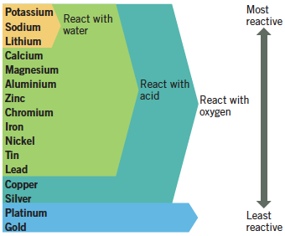
Reactions of Metals

Slide 58
Redox reactions in solutions
Some redox reactions that are important for chemical analysis (determining how much of a particular chemical is present in a sample) include those involving solutions of potassium permanganate, potassium dichromate, iron(II) salts and the oxalate ion, C₂O₄²⁻.
The half-equations for these reactions are:
MnO₄⁻_{(aq)} + 8H⁺_{(aq)} + 5e → Mn²⁺_{(aq)} + 4H₂O_{(l)} reduction
Cr₂O₇²⁻_{(aq)} + 14H⁺_{(aq)} + 6e⁻ → 2Cr³⁺_{(aq)} + 7H₂O_{(l)} reduction
Fe²⁺_{(aq)} → Fe³⁺_{(aq)} + e⁻ oxidation
C₂O₄²⁻_{(aq)} → 2CO_{2(g)} + 2e⁻ oxidation

Slide 59
Redox Titrations
Equivalence point of redox titration occurs when one of oxidant or reductant is used up.
MnO4⁻_{(aq)}+8H⁺_{(aq)}+5Fe²⁺_{(aq)}→Mn²⁺_{(aq)}+5Fe³⁺_{(aq)} +4H₂O_{(l)}
It is possible to use indicators or voltmeters to measure the equivalence point but some of the substances involved have specific colours for example potassium permanganate is purple and iron (II) is colourless

Slide 60
Back titration
The concentration of the atmospheric pollutant sulfur dioxide (SO₂) can be found by bubbling air through a dilute KMnO₄(aq) solution of known concentration.
5SO_{2(g)} + 2MnO₄⁻_{(aq)} + 2H₂O_{(l)} -----> 5SO₄²⁻_{(aq)} + 2Mn²⁺_{(aq)} + 4H⁺_{(aq)}
The concentration of the remaining KMnO₄(aq) can be found by titration with standardised oxalic acid. This allows the amount of KMnO₄ reacting with sulfur dioxide to be found and thus its concentration in the air sample can be calculated.

Slide 61
Procedure
43.9 m³ of SO₂ polluted air was bubbled through 215.0 mL of 5.007 x 10⁻³ mol L⁻¹ KMnO₄(aq).
The unreacted KMnO₄ was acidified and diluted to a volume of 250.0 mL.
20.00 mL samples of this KMnO₄ solution were titrated to equivalence with 38.50 mL of 2.194 x 10⁻³ mol L⁻¹ oxalic acid solution.
What is the concentration of the pollutant SO₂(g) in ppm if the air has a density of 1.18 kg m⁻³

Slide 62
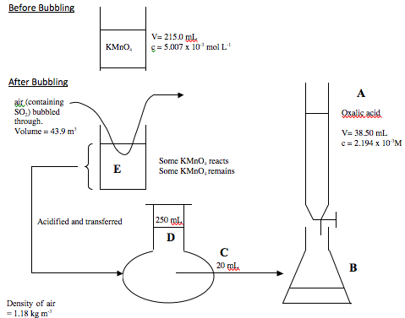

Slide 63
Answer
Before Bubbling
n(KMnO₄) = cV = 0.2150 x 5.007 x 10⁻³ = 1.0765 x 10⁻³ (1 mark)

Slide 64
After Bubbling
A: n(oxalic acid) = cV = 0.3850 x 2.194 x 10⁻³ = 8.4469 x 10⁻⁵
Titration reaction:
2MnO₄⁻(aq) + 6H⁺(aq) + 5H₂C₂O₄(aq) -----> 2Mn²⁺(aq) + 8H₂O_{(l)} + 10CO_{2(g)}
B: n(KMnO₄) = (2/5) x n(oxalic acid) = (2/5) x 8.4469 x 10⁻⁵ = 3.3788 x 10⁻⁵
C: c(KMnO₄) = n/V = 3.3788 x 10⁻⁵ / 0.020 = 1.6894 x 10⁻³M = c(KMnO₄) at
D: n(KMnO₄) = cV = 1.6894 x 10⁻³ x 0.250 = 4.2235 x 10⁻⁴ = n(KMnO₄) at E

Slide 65
Moles of SO₂ reacting
n(KMnO₄)_{reacting with SO2} = n(KMnO₄)_{Before Bubbling} - n(KMnO₄)_{After Bubbling} = 1.0765 x 10⁻³ - 4.2235 x 10⁻⁴ = 6.5416 x 10⁻⁴
n(SO₂) = (5/2) x n(KMnO₄)_{reacting with SO2} = (5/2) x 6.5416 x 10⁻⁴ = 1.6354 x 10⁻³
m(SO₂) = n x M = 1.6354 x 10⁻³ x 64.07 = 1.0478 x 10⁻¹ g = 104.78 mg
This mass is contained in 43.9 m³ of air
mass(air) = density(air) x V = 1.18 x 43.9 = 51.802 kg
c(SO₂)_{ppm} = m(SO₂)_{mg} / mass(air)_{kg} = 104.78 / 51.802 = 2.02 ppm

